Slide 1

Baseball Performance Analyzer
Gregory imolehin
Valera stettner

Slide 2

Improving baseball athletes with important data insights
Offering data-driven recommendations for improving player skills and tactics.
Supporting coaches and team managers in making an informed decision

Slide 3
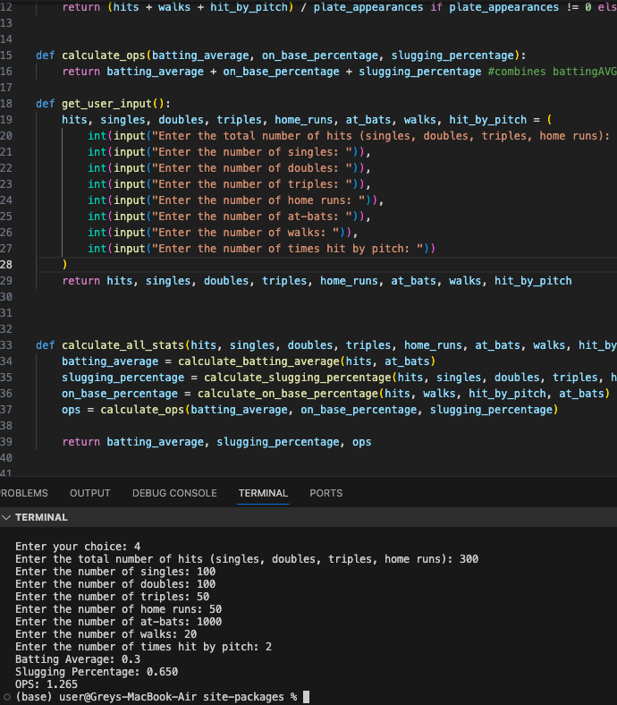


Calculating an Athlete’s Baseball Statistics(Batting average, Slugging percentage and OPS)

